Slide 1
Structural brain changes as a function of second language vocabulary training:
Effects of learning context
Jennifer Legaulta, Shin-Yi Fanga, Yu-Ju Lanb, Ping Lia (2019)
Presenter: Kang Haixuan
01/04/2026

Slide 2
Overview
1. Background & Motivation (Why)
Why study L2 learning?
What is the research gap?
2. Research Design (How)
Participants and tasks
PW vs VE learning conditions
3. Key Findings (What)
Structural brain changes
Context-specific differences
4. Interpretation & Implications (So what)
Links to course concepts and real-world relevance
Critical evaluation

Slide 3
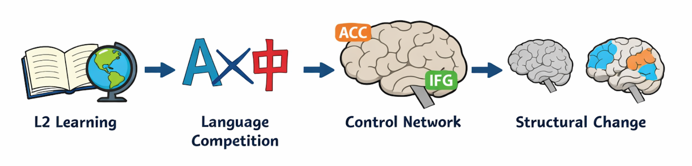
Background
Fig. 1. L2 learning pathway (AI-generated).
L2 learning ➡️ neuroplasticity ➡️ cortical thickness (CT) & gray matter volume (GMV)
Occuring in a language control network → e.g. ACC, IFG, IPL (attention, inhibition, working memory)
Memory ➕ managing competing languages
Learning experience may shape how the brain reorganizes
Page #

Slide 4
Research Gap & Motivation
What we know
L2 learning leads to structural brain changes
Changes are observed in the language control network
Most studies focus on long-term learning
What we don’t know
Can short-term L2 learning change brain structure?
Does learning context matter: Picture-Word (PW) vs Visual Environment (VE)
Do different contexts recruit different neural mechanisms?
Motivation of this study
To examine how learning context shapes brain plasticity
Page #

Slide 5
Research Questions & Hypotheses
Research Questions
Can short-term L2 vocabulary learning induce structural brain changes?
Do different learning contexts (PW vs VE) lead to different neural changes?
Are these brain changes related to learning performance and cognitive abilities?
Hypotheses
Both L2 groups will show increases in CT and GMV in language control regions
The VE group will recruit a more distributed / multimodal network
Brain changes will correlate with L2 learning performance
Page #

Slide 6
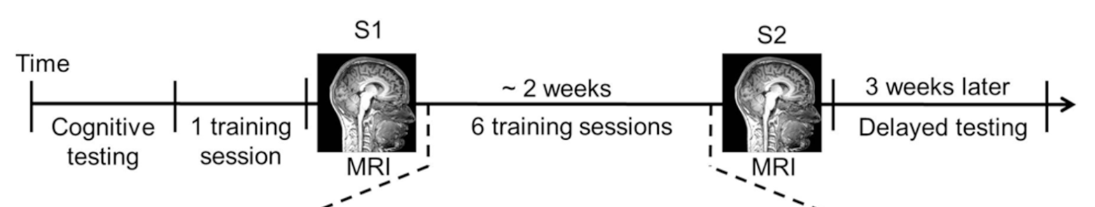
Participants & Study Design
Training Groups:
average 21.9 years old (19-33)
VE Group: 19 participants
PW Group: 17 participants
Control Group:
15 participants
average 20.47 years old (18-22)
Fig. 2. Study procedure (Legaulta et al., 2019).
Page #

Slide 7
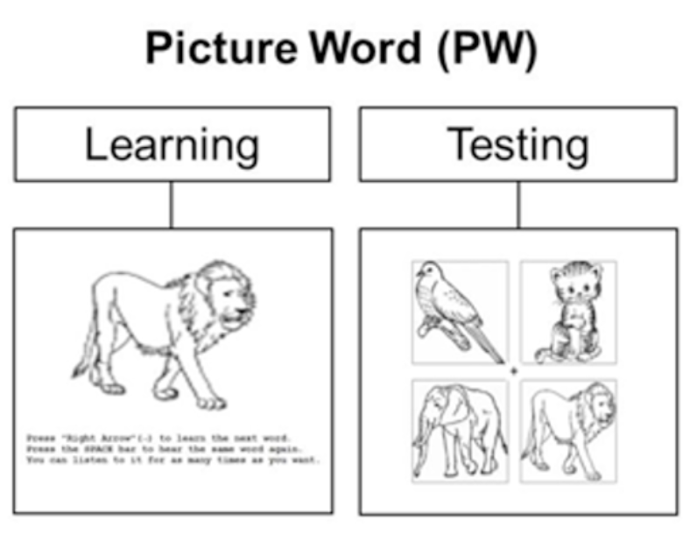
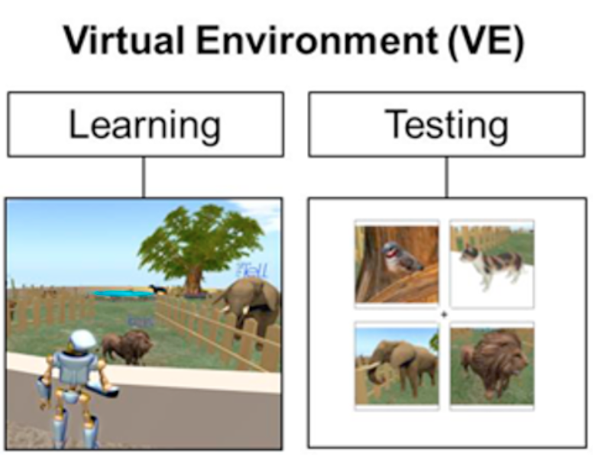
Learning Conditions (PW vs VE)
Picture-Word (PW) Condition
2D image paired with a spoken Mandarin word
Simple associative learning
Focus on form–meaning pairing
Virtual Environment (VE) Condition
Navigate a 3D virtual environment
Interactive and contextual learning
Involves multimodal input (visual, spatial, motor)
Learning the same words but
PW: explicit association
VE: contextual & embodied learning
Fig. 3. Training conditions (Legaulta et al., 2019).

Slide 8
Measures
Behavioral Measures
Accuracy (word recognition performance)
Reaction time
Delayed retention tests
Learning efficiency (exposure vs performance)
Brain Measures (Structural MRI)
Cortical Thickness (CT) ➡️ thickness of the cortex
Gray Matter Volume (GMV) ➡️ amount of gray matter in a region
Focus：Changes from MRI Session 1 to Session 2
Page #

Slide 9
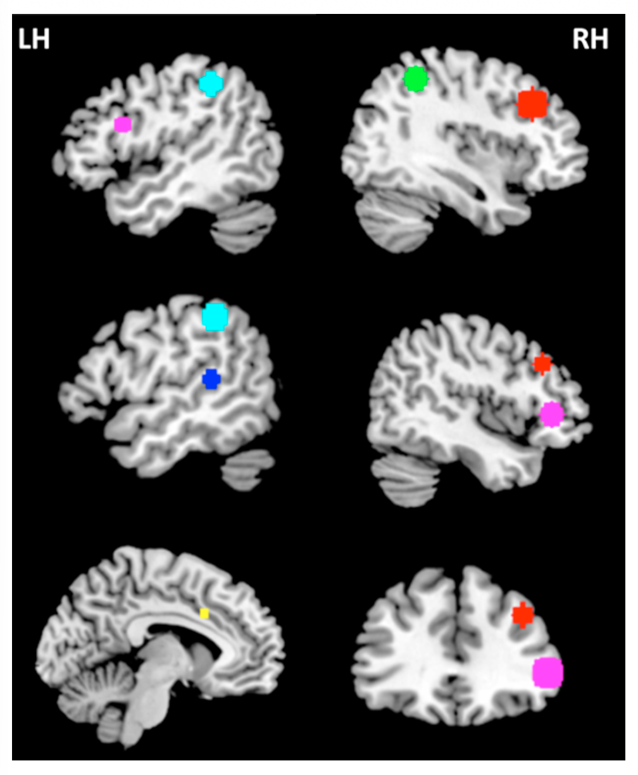
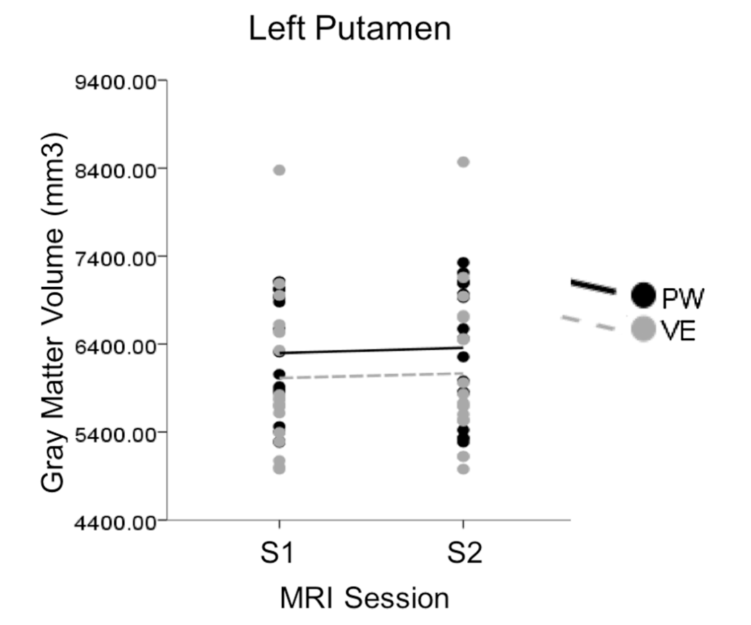
Main Findings (Shared Changes)
Increased cortical thickness (CT) in multiple regions:
R-MFG
R-SPL
L-ACC
L-SMG
L-STG
Bi-IFG
Increased gray matter volume (GMV) in putamen
Fig. 4. CT increases over time for both training groups (Legaulta et al., 2019).
Fig. 5. GMV increases over time for both training groups (Legaulta et al., 2019).

Slide 10
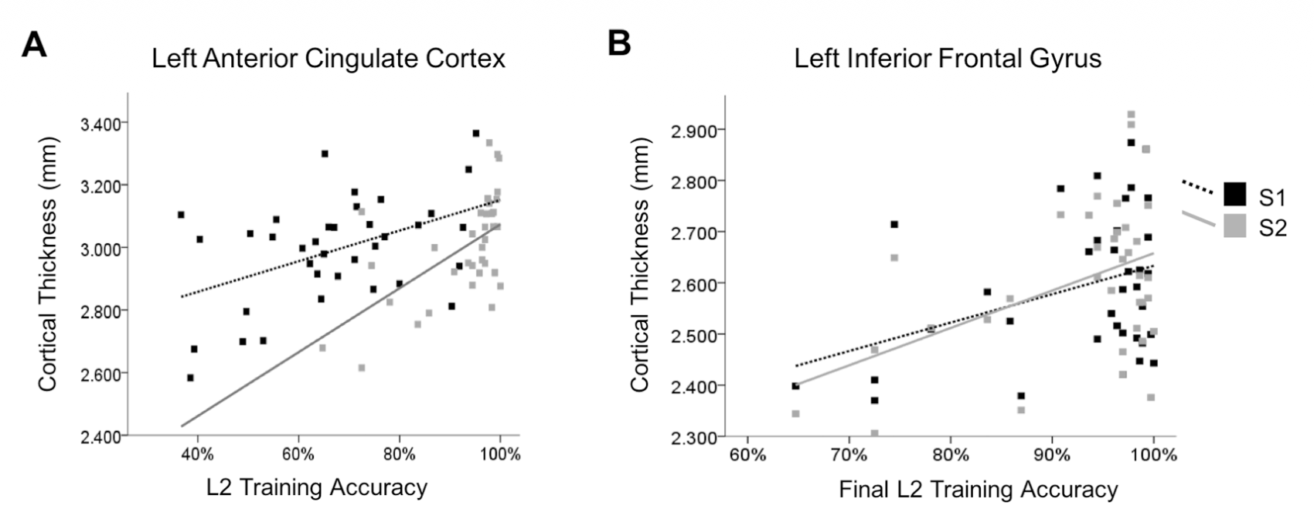
Main Findings (Shared Changes)
Overall training accuracy ➡️ positively correlated with L-ACC thickness
Late-stage learning accuracy (Sessions 4–7) ➡️ positively correlated with L-IFG thickness
Accuracy ➡️ positively correlated with GMV in L-IPL
Fig. 6. CT correlates with L2 training accuracy at S2 (Legaulta et al., 2019).

Slide 11
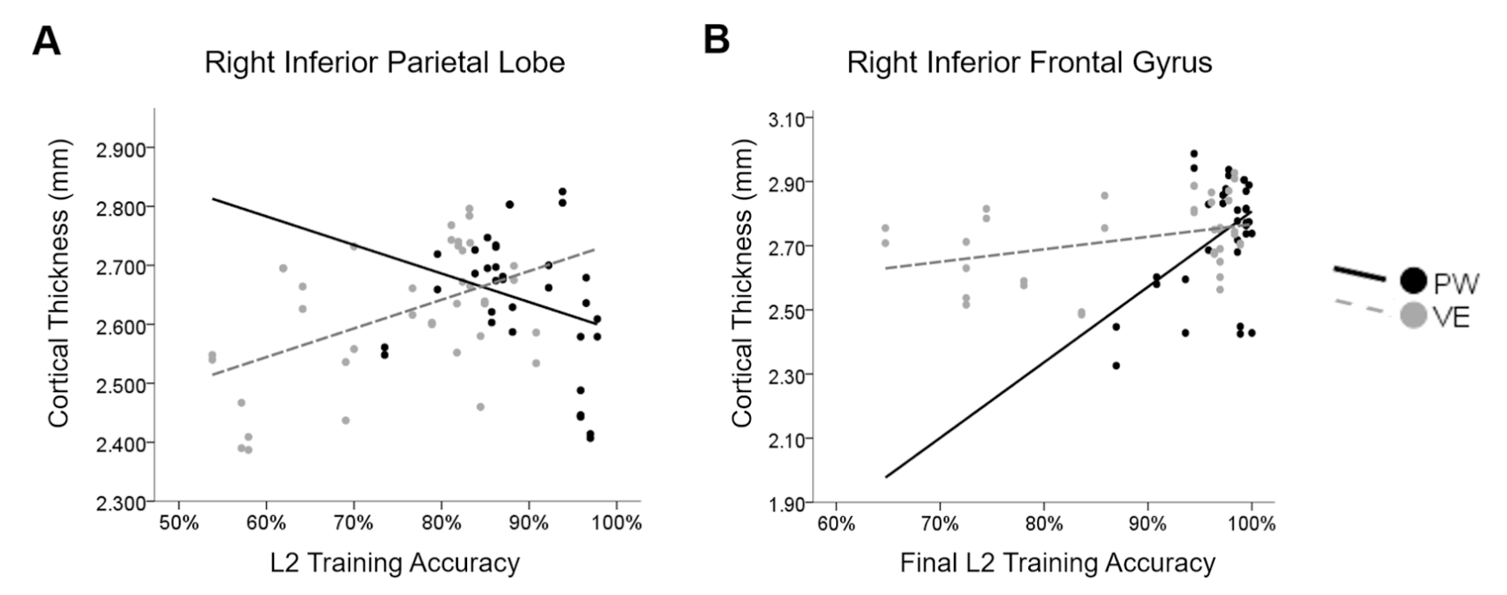
Comparative Findings
Different neural pathways (RH)
VE group
accuracy positively correlated with R-IPL thickness
PW group
accuracy negatively correlated with R-IPL thickness
late-stage accuracy positively correlated with R-IFG thickness
Fig. 7. CT relationship with L2 accuracy varies by L2 training group(Legaulta et al., 2019).

Slide 12
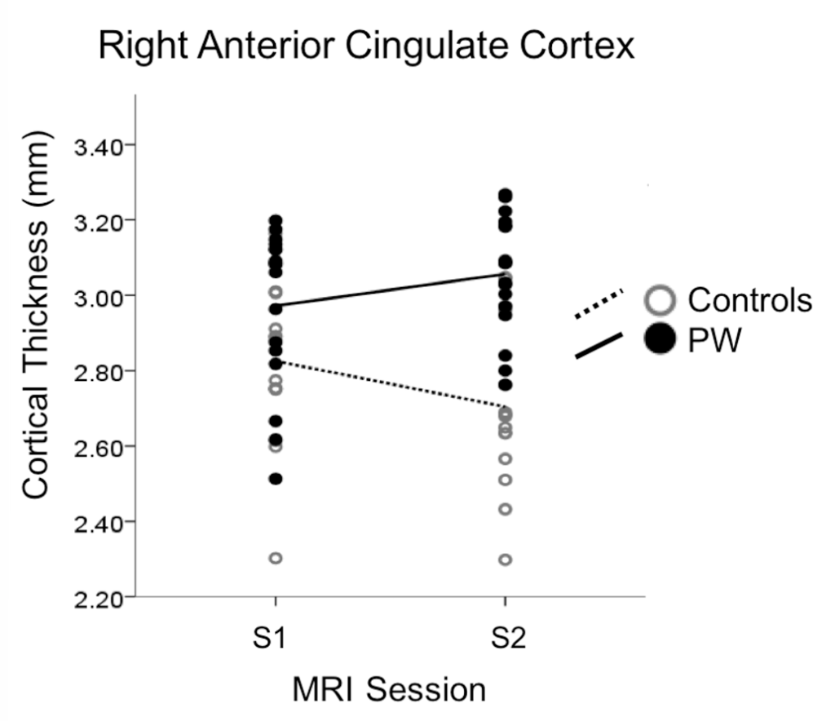
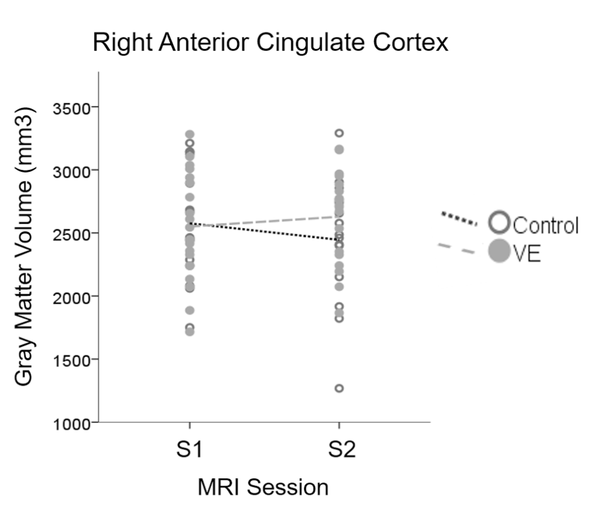
Comparative Findings
R-ACC thickness after training
PW Group > Control Group
GMV amounts in R-ACC after training
VE Group > Control Group
Fig. 8. CT increases for PW group as compared to controls (Legaulta et al., 2019).
Fig. 9. GMV increases for VE group as compared to controls (Legaulta et al., 2019).

Slide 13
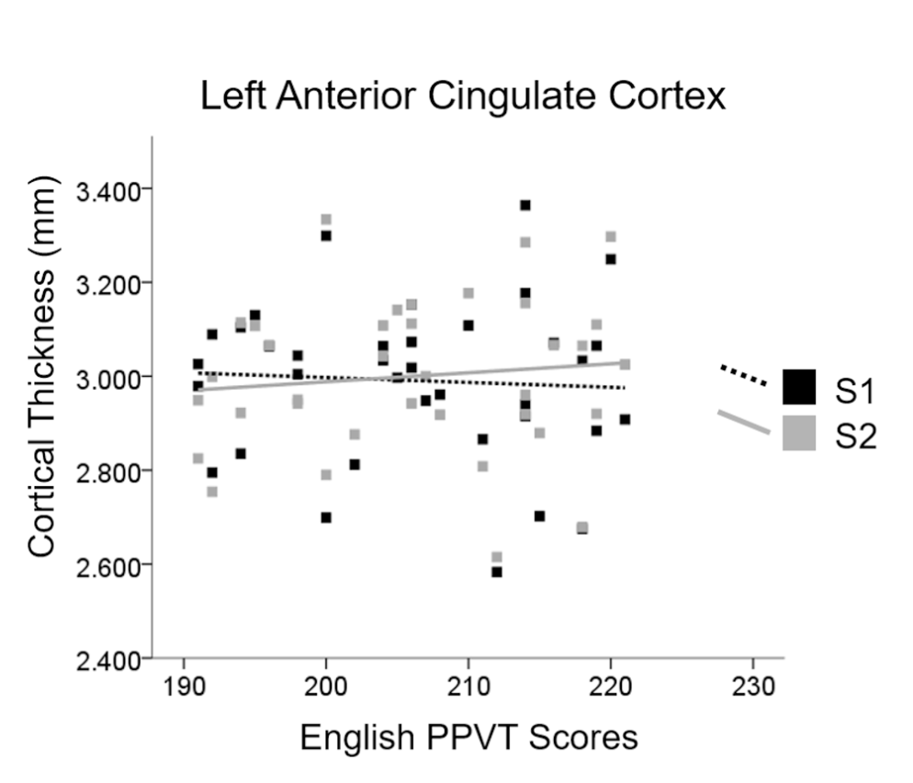
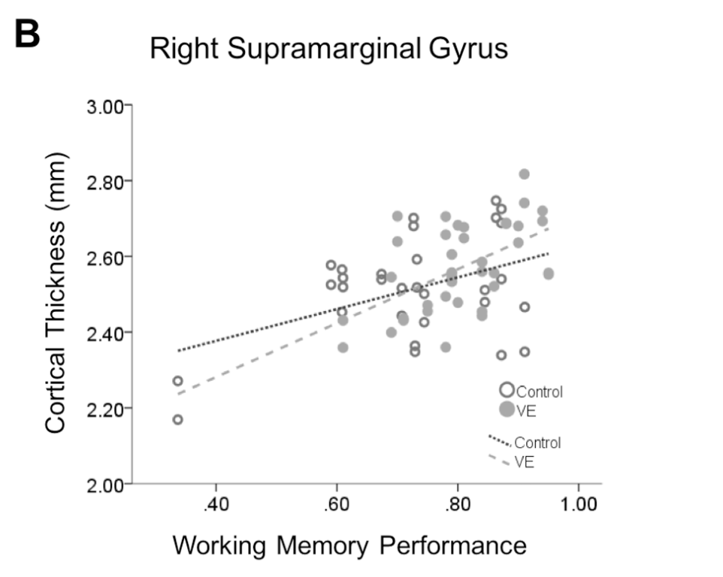
Comparative Findings (Individual-specific)
Comparative Findings
L1 ability (PPVT)
higher PPVT ➡️ greater L-ACC change
Working memory (LNS) (VE only)
WM positively correlated with R-SMG thickness
Fig. 10. CT correlates with L1 proficiency (Legaulta et al., 2019).
Fig. 11. CT relationship with L2 accuracy for PW Group (Legaulta et al., 2019).

Slide 14
Interpretation
1. Learning context shapes neural pathways
PW ➡️ explicit control (IFG) ➡️ form–meaning association/translation-like processing
VE ➡️ embodied integration (IPL/SMG) ➡️ multimodal semantic representation
2. Rapid neuroplasticity
Structural changes occur within weeks
Language control network shows fast reorganization
Page #

Slide 15
Interpretation
3. Embodied learning advantage (VE)
More efficient learning (fewer exposures)
More robust retention (delayed test → SMG)
4. Role of cognitive systems
ACC ➡️ conflict monitoring (L1 vs L2)
Putamen ➡️ phonological / articulatory processing
5. Individual differences × context
L1 ability ➡️ better ACC adaptation
Working memory ➡️ only relevant in VE

Slide 16
Connection to Our Course
1. Shared vs. distinct neural representation
Course: L1 & L2 share a broad network, but are not identical
Study: PW vs VE ➡️ different neural pathways (IFG vs IPL)
2. Assimilation vs. accommodation
Course:
L2 can reuse L1 network (assimilation)/recruit new regions (accommodation)
Study:
PW ➡️ assimilation-like (translation-based)
VE ➡️ accommodation (new multimodal integration)
Page #

Slide 17
Connection to Our Course
3. Language control network
Course: ACC, IFG, basal ganglia ➡️ control & conflict monitoring
Study: ACC, IFG, IPL show structural changes ➡️ linked to learning performance
4. Neural consequences of bilingualism
Course: bilingual experience ➡️ structural brain changes
Study: even short-term learning (~20 days) induces changes
5. Proper experimental comparison
Course: brain activity alone is not interpretable without a baseline/control (e.g., hippocampus activation example）
Study: PW vs VE vs No-training Control Group

Slide 18
Critical Evaluation
Strengths
Longitudinal design + control group → supports causal interpretation
Combines behavior + brain measures → links structure to performance
Limitations
Short training duration (~20 days) → unclear long-term effects
Focus on vocabulary only → limited generalizability
Open Questions
Does VE advantage persist in real-world learning?
How do findings extend to other language skills?

Slide 19
Takeaway & Implications
Takeaway
Brain structure can change within weeks
L2 learning strengthens the language control network
Learning context determines neural pathways → PW (IFG) vs VE (IPL)
Implications
Embodied learning (VE) ➡️ more efficient & more durable learning
Educational technology ➡️ virtual environments can simulate immersion
Individualized learning ➡️ match methods to cognitive abilities
Final message
Learning environment does not just affect outcomes — it reshapes how the brain learns
Page #

Slide 20
MCQ 1: Research Design
What is the key advantage of comparing the PW and VE conditions in this study?
i. They allow researchers to test whether different learning contexts recruit different neural mechanisms ii. They ensure that participants learn different sets of vocabulary words iii. They isolate the effect of learning context while keeping learning content constant iv. They eliminate the need for a control group
A) only i B) i and iii C) i, ii and iii D) ii and iv E) all of the above

Slide 21
MCQ 2: Results Interpretation
Based on the study’s findings, what are the best interpretation of the difference between PW and VE learning?
i. PW learning relies more on frontal control processes (e.g. IFG) ii. VE learning engages more multimodal and integrative processing (e.g. IPL) iii. VE learning leads to universally better performance than PW learning iv. Learning context influences the neural pathways used during learning
A) i and ii B) i, ii and iv C) ii and iii D) i, iii and iv E) all of the above
Page #

Slide 22
THANK YOU
Page #

